Slide 1
Topic: Right-angled triangles
EQ – How do we find an angle of a right angled triangle using trigonometry ratios?

Slide 2
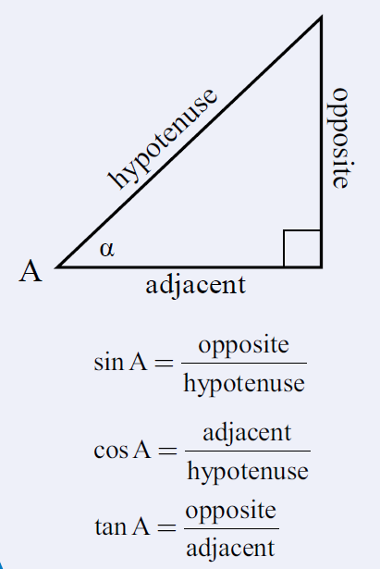
24
7
30
Date:
Right-angled triangles
EQ – How do we find an angle of a right angled triangle using trigonometry ratios?
From our last lesson
What are the trigonometry ratios?
25

Slide 3
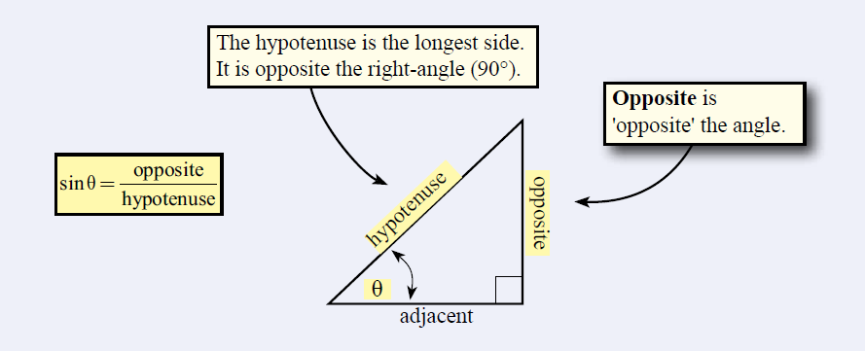
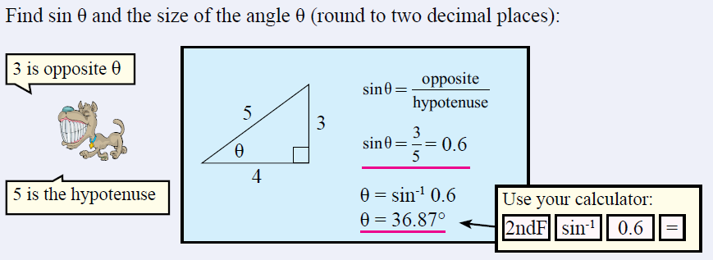
24
7
30
Date:
Right-angled triangles
EQ – How do we find an angle of a right angled triangle using trigonometry ratios?
The sine ratio
25

Slide 4
Ex. 3: Find θ. Round to three decimal places.
200
400
2nd
sin
200
400
)

Slide 5
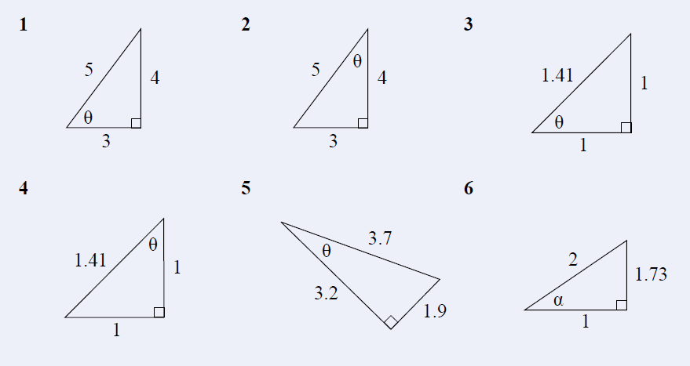
Task- Use sine ratio to find the unknown angle

Slide 6
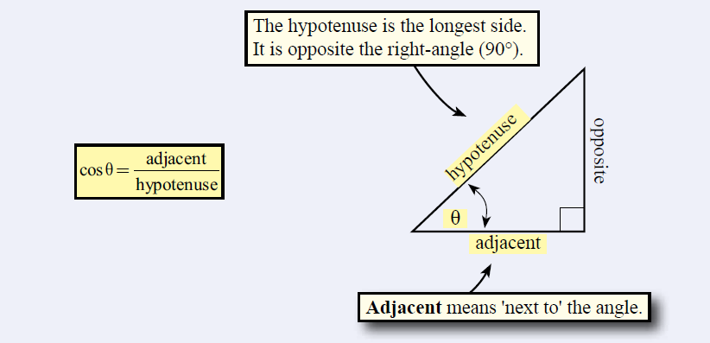
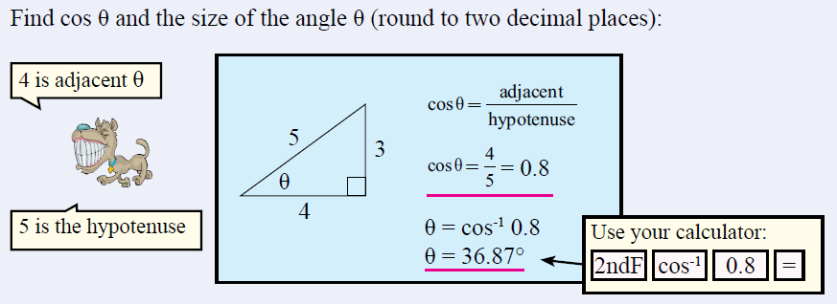
24
7
30
Date:
Right-angled triangles
EQ – How do we find an angle of a right angled triangle using trigonometry ratios?
The cosine ratio
25

Slide 7
Ex. 2: Find θ. Round to three decimal places.
7
2nd
cos
7
23
)
23
Make sure you are in degree mode (not radians).

Slide 8
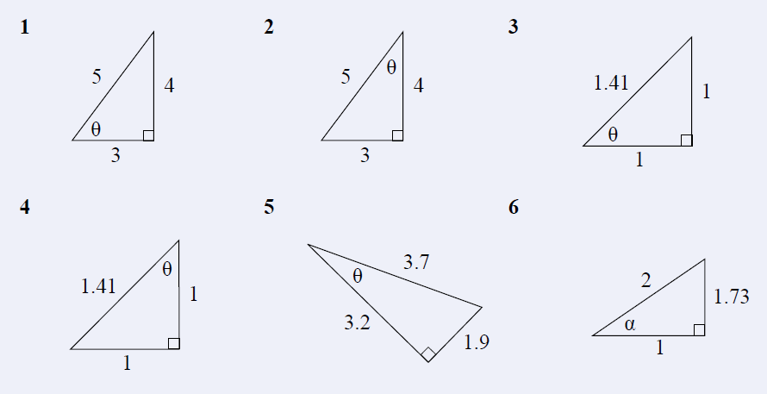
Task- Same set as before but this time….Use cosine ratio to find the unknown angle

Slide 9
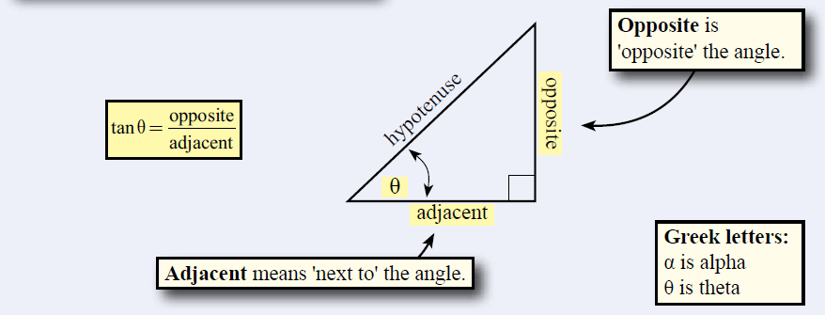
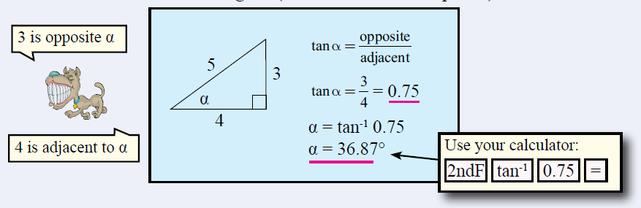
24
7
30
Date:
Right-angled triangles
EQ – How do we find an angle of a right angled triangle using trigonometry ratios?
The tangent ratio
25

Slide 10
Ex. 1: Find θ. Round to four decimal places.
2nd
tan
17.2
9
)
17.2
9
Shrink yourself down and stand where the angle is.
Now, figure out which trig ratio you have and set up the problem.

Slide 11
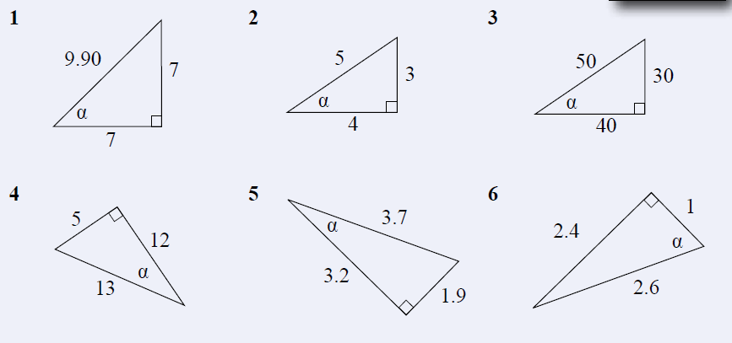
Task

